Slide 1
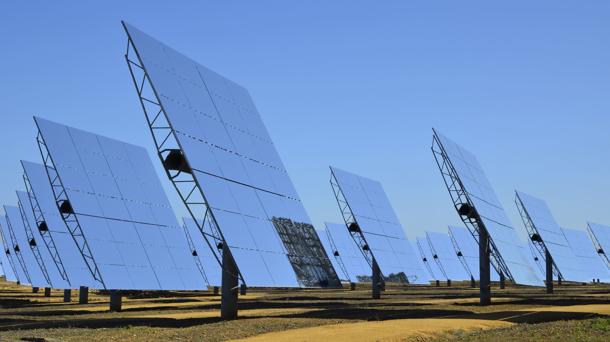
Task 1: Lumicharge: Powering the Future with Solar Innovation
Student ID:
Student Name:

Slide 2
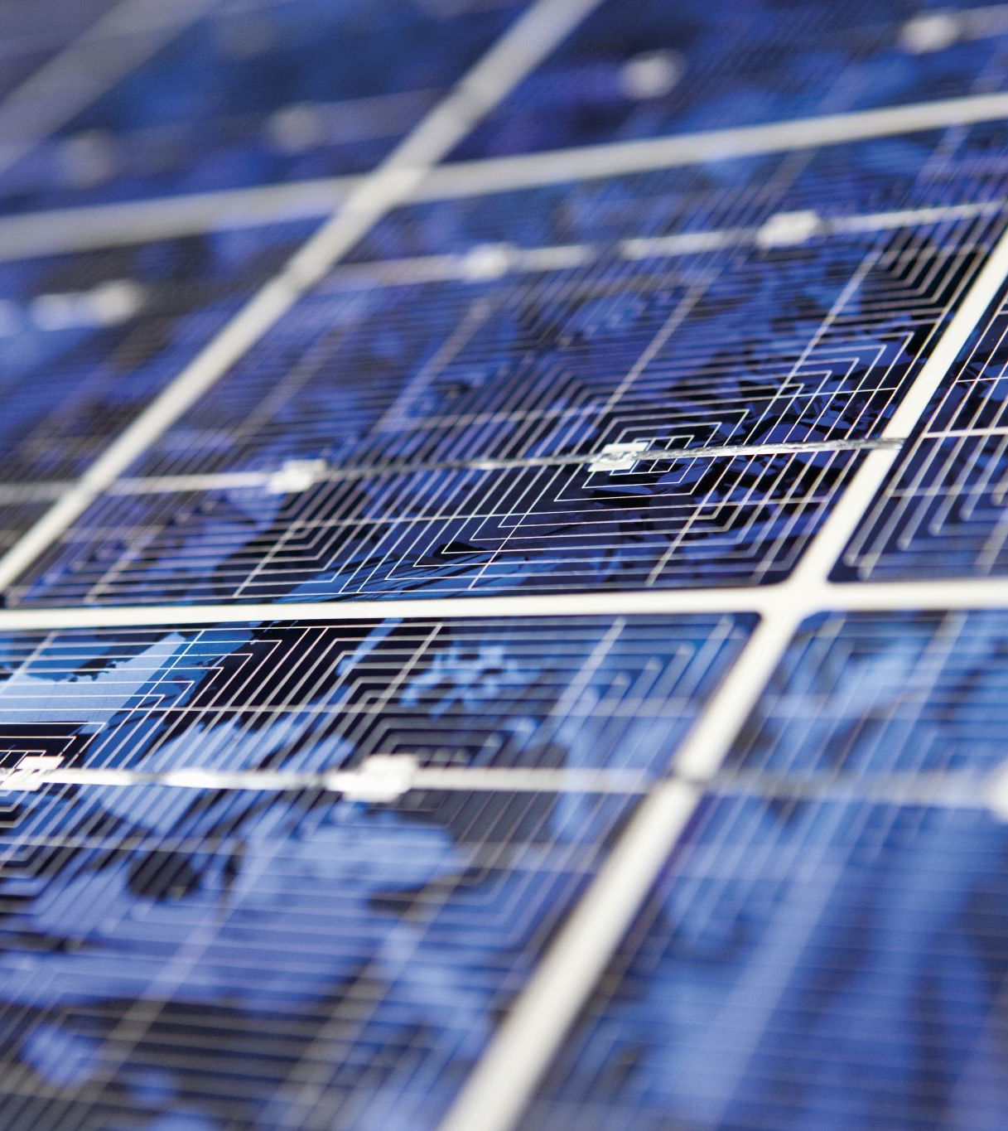
Introduction
LumiCharge: UK clean-tech start-up creating solar-powered mobile charging pods.
Responding to global demand for sustainable, portable charging.
Expanding into the UK using PESTLE, market data, and a clear investment plan.
Notes:
We are pleased to present our investor vodcast. LumiCharge is the name of our business, a start-up company based in the UK, specialising in creating mobile phone charging pods powered by solar energy as portable devices. Our business responds to the growing worldwide interest in sustainable charging solutions. This is our international expansion strategy today: the United Kindom, a high-growth market in clean energy. We will present our business idea, support our choice of the market with PESTLE and reliable statistics, analyse the situation on the UK demand, discuss our competitors, refer to the internationalisation theories and draw conclusions, finally, risk, possibility, and definite investment request.

Slide 3

The Problem & Our Solution
Rising mobile dependency but limited outdoor/ travel charging access.
UK still highly grid-dependent with low sustainable charging options.
Lumicharge: compact, solar-powered, portable, eco-friendly charger.
Meets sustainability goals and supports a mobile, on-the-go lifestyle.
Notes:
There have been increasing cases of global mobile dependency, but access to effective charging persists in an uneven manner, in the outdoor and travel and tourism environments. UK, despite technological advancement, is a country with a high proportion of grid dependence and minimal charging infrastructure sustainability. Lumicharge is a small, solar-powered device capable of being charged by sunlight or indoor light, and has reliable, portable, earth-friendly power. We are going to offer a solution consistent with the global sustainability concerns, energy-saving, and mobile lifestyle. It is an innovative, clean-tech consumer, traveller, and outdoor device.

Slide 4
Why UK? PESTLE Market Justification
Strong government support for clean-tech (Net Zero 2050).
High GDP per capita and strong tech retail sector.
97%+ smartphone usage and heavy tourist mobility.
Strong clean-tech and smart city innovation demand.
Favourable import/green-energy policies.
Intense sunlight ideal for solar products.
Overall high strategic fit for entry.
Notes:
We have strong strategic alignment with the UK conditions as revealed in our PESTLE analysis. Political: The UK government facilitates green innovation by incorporating long-term sustainability plans like the UK Net Zero 2050 Initiative (UK, 2024). Economic: The economic level is high, with the largest level of GDP per capita and a growing technological retail industry in the country. Social: The rate of smartphone use is above 97, and urban and tourist life is ruled by a mobile lifestyle (Statista, 2016). Technological: UK invests in the sphere of clean-tech and smart cities development that would generate demand for innovative charging devices. Law: New entrants are favourable under favourable import and clean-energy policies. Environmental: The UK has the highest exposure to sun rays, making it the best place to use products that are powered by the sun. All these factors contribute to an exciting desired market entry.

Slide 5

Market Research: Demand Trends
Rising demand for sustainable tech accessories.
GCC markets shifting toward greener electronics (Statista, 2024).
Tourism + outdoor lifestyle = constant charging needs.
Clean-tech imports rising 22% yearly (UNCTAD, 2023).
85%+ residents own multiple smart devices → high need for portable charging.
Notes:
Statistics show that sustainable charger accessories are in high demand. According to Statista (2016), there is an increasing demand in the GCC markets for greener electronics. The large digital use and tourism, as well as the outdoor lifestyle, structure of the UK, leave mobile charging in constant demand. UNCTAD (2023) points to the fact that the importation of clean-tech devices into the region increases by 22% annually. Moreover, more than 85% of UK residents are possessors of at least two or more smart devices, which implies that the necessity to have portable charging is widespread. With clean-energy behaviour coupled with high technological adoption, the UK has a high and increasing demand profile of Lumicharge.

Slide 6
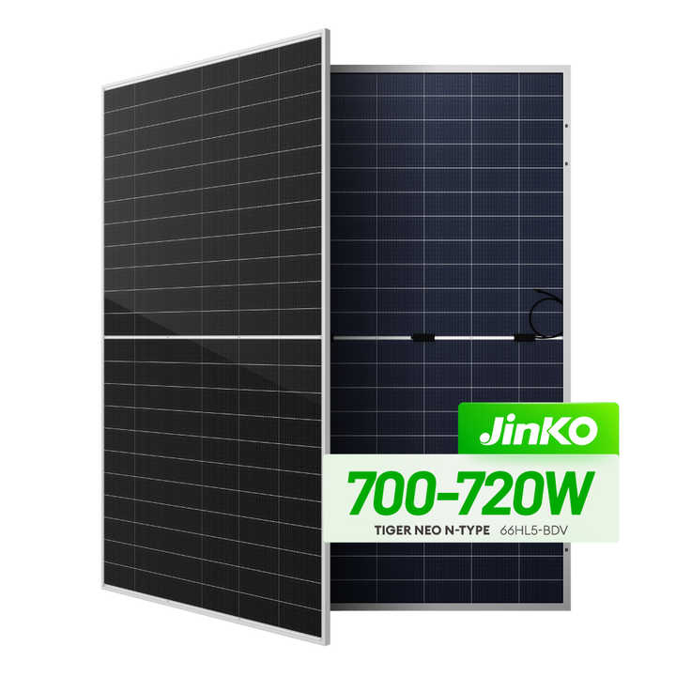
Market Research: Competitor Landscape
Few quality solar-powered chargers on the market.
Mostly low-end imports and basic camping chargers.
Main retailers sell grid-charged power banks.
Clear niche for premium smart solar charging.
Lumicharge offers durability, fast charge, and AI energy optimisation.
Notes:
The competitor analysis indicates that there is a low supply of quality solar-powered portable chargers. The current competition comprises generic low-priced Chinese imports and simple outdoor camping chargers, none of which have advanced smart capabilities and high-efficiency solar conversion. Power banks that are charged by the grid are mostly sold by major electronics brands in the UK, including Sharaf DG and Jumbo Electronics (Oviatt and Mcdougall, 2017). This indicates the existence of an obvious market niche for a competent, high-end, smart solar product. Lumicharge makes its product stand out by its exceptionally high durability, increased charging speed, compatibility with various devices, and AI-controlled energy optimisation. The competitor environment is thus supportive of a disruptive, clean-tech entrant.

Slide 7
Consumer Insights & Preferences
Key segments: professionals, tourists, outdoor users.
Customers want fast, convenient, sustainable charging.
UK buyers willing to pay for premium eco-tech.
Cultural preference for trusted, high-quality brands.
Notes:
Our consumer study identifies three key segments, which are: tech-savvy professionals, tourists, and users of the outdoor lifestyle. Customers value convenient and sustainable, and quick charging options. UK customers are willing to spend more on high-technology products that are environmentally friendly (Zucchella, Hagen and Serapio, 2018). The cultural dimensions proposed by Hofstede indicate that they would prefer familiar brands and hi-tech solutions, which strengthens the necessity to have effective product positioning, quality assurance, and retail partnerships. This knowledge would validate high consumer intent on Lumicharge.

Slide 8
Entry Strategy: Theoretical Justification
Mix of Uppsala (gradual learning) + Born Global (early expansion).
High-tech nature enables rapid internationalisation.
Indirect exporting with UK partner reduces risk and boosts access.
Supports retail visibility and fast scaling.
Notes:
Internationalisation strategy is a synthesis of the Uppsala Model and the Born Global Theory. The Uppsala model implies the gradual growth due to the basis of the experience-sharing, but Lumicharge has high-tech competence and a scalable product to enter proficiently across the globe. This is in line with Born Global features- firms that internationalise at a young age because of the intensity of innovation, and niche demand (Al-Laham, Welge and Joachim Schwalbach, 2009).
Our exporting model of choice is the Network Theory-supported indirect exporting model with a UK partner, who will assist in countering uncertainty and accessing the market better.
This mode of entry is less risky; it offers established distribution channel opportunities, as well as fits the preference of trust in the store and brand visibility, which is the choice of UK consumers. It also enables us to scale fast in high-end retail and tourism markets.

Slide 9
Logistics & Operational Plan
Manufacturing in UK with strict quality and IP control.
Shipping to UK warehouses for distribution.
Retail partnerships: Carrefour, Virgin, Sharaf DG, airports.
UK service partner manages after-sales.
Notes:
Lumicharge will produce and assemble its products in the UK using special clean-technology assembly houses, and the quality will be highly controlled, and the IP secured. Goods will be transported through the UK-UK shipping and stored in Dubai logistics centres to be shipped to retailers such as Carrefour, Sharaf DG, Virgin Megastore and airport stores (Prabhu TL, 2019). This will simplify operations, and we can utilise the global logistics system available in the UK and consistent with our strategy of gradual scaling. The after-sales services to the customers will be handled by the service partner based in the UK.

Slide 10

Risks & Opportunities
Risks: competition, import costs, tech imitation.
Mitigation: IP protection, distribution contracts, currency hedging.
Opportunities: first-mover advantage in premium solar charging.
Strong fit with UK sustainability goals and tourism partnerships.
Notes:
The major threats are the market competition, cost fluctuations in imports, and technological imitation. To overcome these, we will ensure that we enter into a distribution agreement enabling it to secure retail shelf position, hedge against exchange rates, and safeguard our proprietary solar charging algorithm by UK IP registration (Zucchella, Hagen and Serapio, 2018).
The opportunities consist of the first-mover advantage with premium solar portable charging, adherence to sustainability policies in the UK, and cooperation with tourism, events, and government projects. LumiCharge will grow quickly with its high brand presence and local retail outlets.

Slide 11

Investment Pitch & Closing
Seeking £500,000 for scaling, UK entry, and marketing.
Strong demand, low competition, and supportive UK environment.
High-growth clean-tech opportunity for investors.
Notes:
Cost Category
Description
Estimated Cost (£)
Product Manufacturing & Scaling
First production batch of 20,000 units; component sourcing; quality control; assembly costs
£160,000
Research & Development
Efficiency testing, durability trials, firmware optimisation, prototype refinement
£30,000
UK–UK Logistics Setup
Freight shipping, customs clearance, and warehousing in the Dubai logistics hub
£40,000
UK Market Launch & Distribution Partnerships
Distributor contracts, retail onboarding fees (Carrefour, Sharaf DG, Virgin Megastore)
£60,000
Marketing & Promotional Campaigns
Digital marketing, influencer partnerships, launch events, expo participation, promotional materials
£85,000
Branding & Packaging Design
Retail-ready packaging, localisation for the UK market, and sustainability certifications
£15,000
Legal, Compliance & Intellectual Property Protection
UK product registration, UK IP filing for solar algorithm, and legal consultation
£35,000
Operations & Customer Support Setup
UK-based service partner, warranty system, support training
£25,000
Team Expansion & Talent Costs
Hire UK Sales Partner + part-time Business Development Executive
£35,000
Contingency Fund (10%)
Unforeseen expenses, currency fluctuations, and emergency production adjustments
£15,000
Total Investment Required
—
£500,000
Total Investment Required — £500,000
We are also trying to raise £500,000 of seed funding to finance the product scaling, entry into the UK market, and marketing of the product in the region. Having high demand, a positive PESTLE framework, minimal competition, and developed clean-tech innovation, Lumicharge offers high growth potential investment. Our approach provides long-term scalability and sustainable value, as well as high correspondence to the UK clean-energy priorities (UNCTAD, 2023). We are encouraging investors to join us in revolutionising portable charging using solar power innovation. That is all the time you have. Thank you, and we do not mind your questions.

